Slide 1
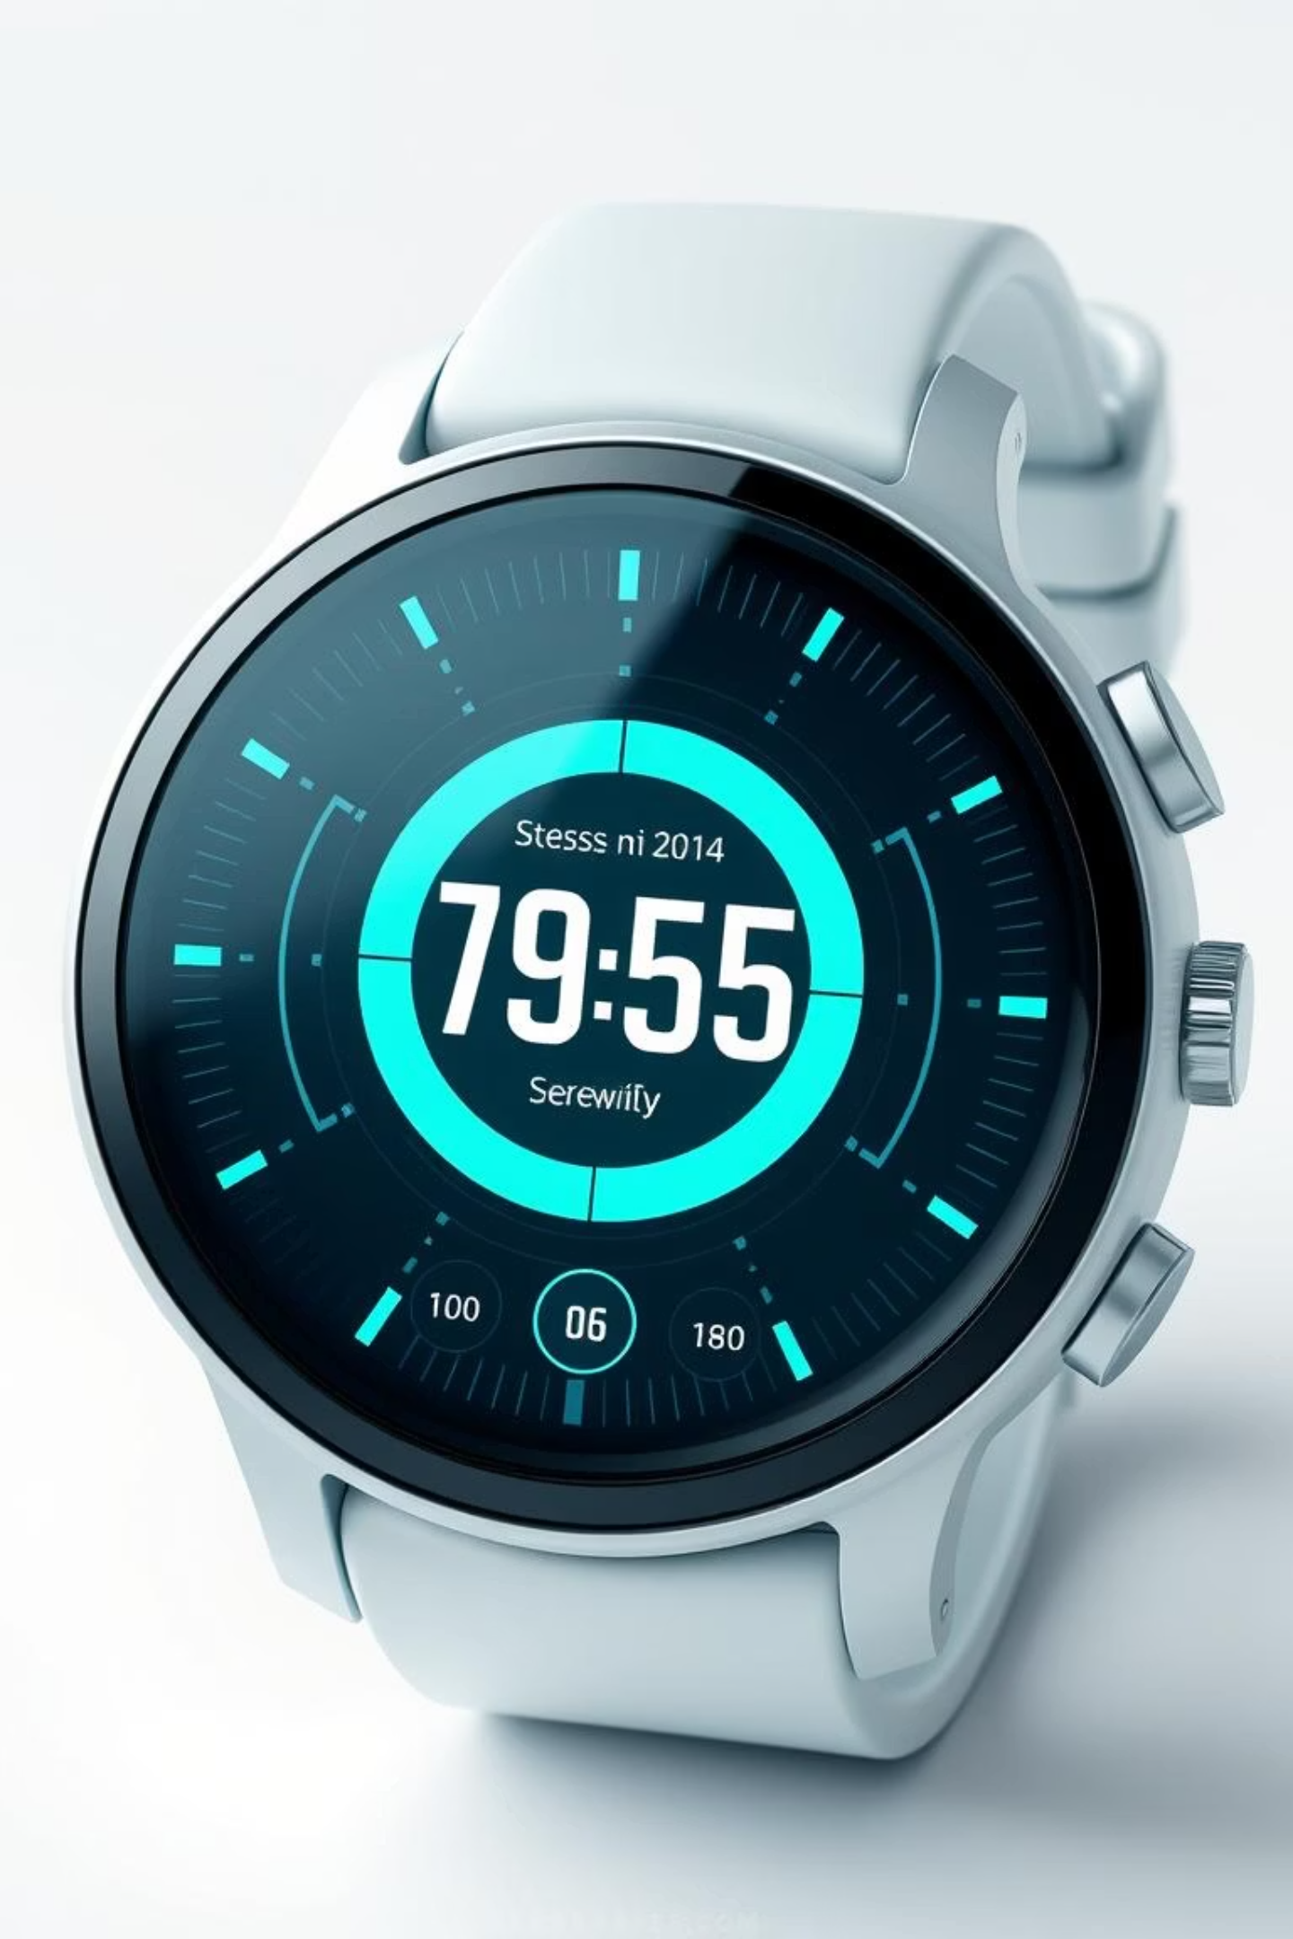
Stress Level Detection Using Machine Learning
Early stress detection is crucial for enhancing overall health and productivity. With approximately 80% of workers globally affected by stress, as reported by the American Institute of Stress, the need for effective solutions is paramount. Machine learning offers a promising approach for real-time, accurate, and non-invasive stress monitoring.

Slide 2
Problem Statement: Addressing the Silent Epidemic of Stress
Health Ramifications
Traditional Limitations
Stress contributes to severe mental and physical health issues, including anxiety, depression, and cardiovascular diseases.
Manual stress detection methods are often costly, time-consuming, and prone to subjective interpretation.
Automation Imperative
Classification Challenge
There is a critical need for automated, continuous, and non-invasive systems to monitor stress effectively.
Accurately classifying stress levels from diverse physiological and behavioral data presents a significant challenge.

Slide 3
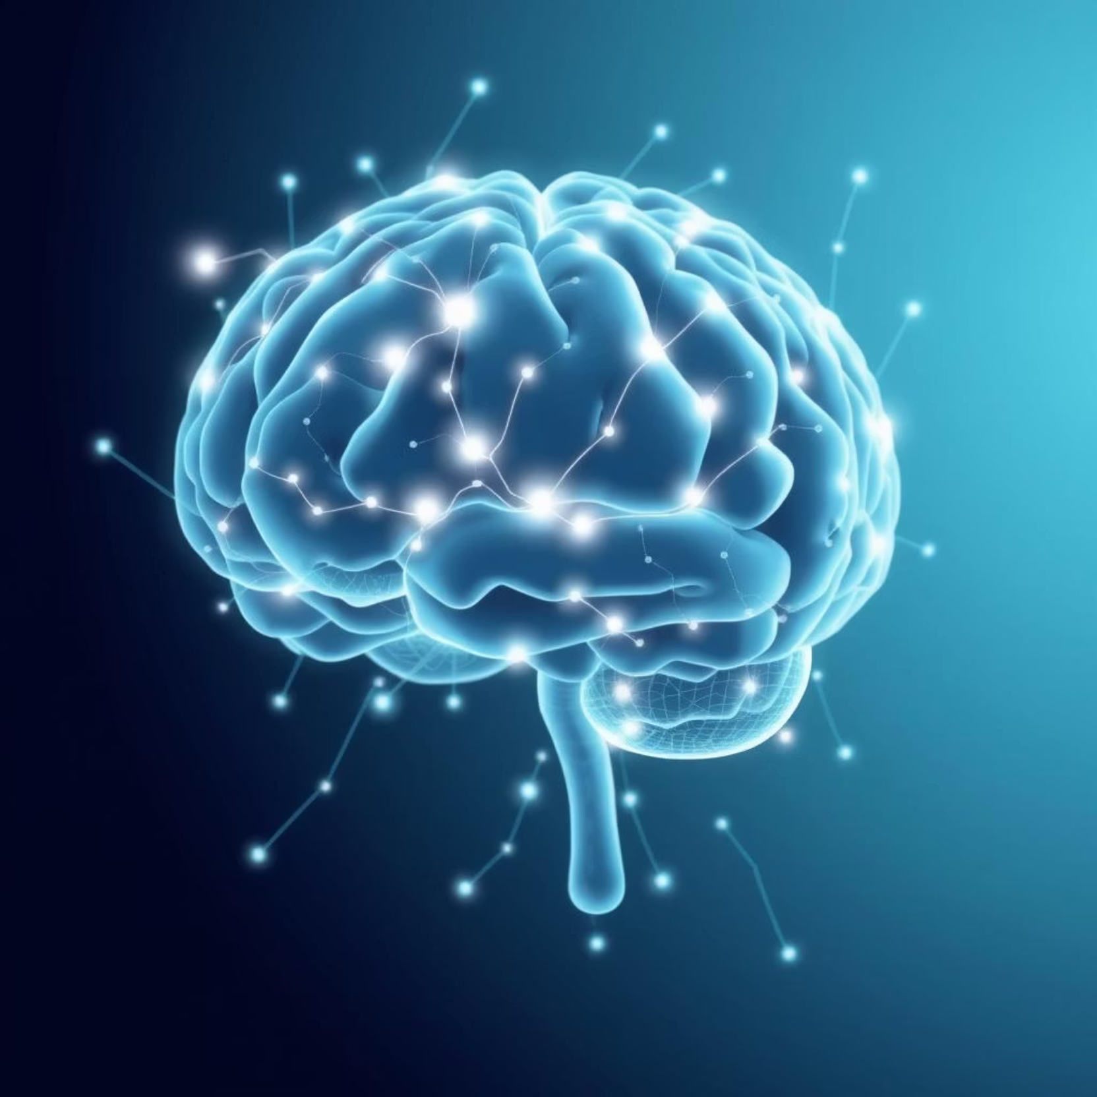
Introduction to ML-Powered Stress Detection
Stress is the body's natural response to perceived external or internal pressures. Our approach leverages machine learning to analyse various data sources, enabling precise classification of stress levels (low, medium, high).
Physiological signals such as Electrocardiogram (ECG) and Galvanic Skin Response (GSR), along with behavioral data like typing patterns and mouse movements, provide rich datasets for our models. This system facilitates early intervention, promotes personalised stress management strategies, and optimises workplace well-being.

Slide 4


Existing Stress Detection Systems: A Comparative View
Traditional Methods
Sensor-Based Systems & ML
Conventional methods like psychologist assessments and lengthy questionnaires are often time-consuming and lack real-time insights.
Modern approaches incorporate wearable sensors measuring heart rate and skin conductance. Machine Learning models like SVM, Random Forest, Decision Trees, and Deep Neural Networks achieve accuracies ranging from 50% to 95%, depending on data quality and model complexity.

Slide 5




Proposed System: Advancing Stress Detection with Hybrid ML
Hybrid ML Model
Wearable Data Collection
Combining Gradient Boosting Machine and Random Forest for robust analysis.
Utilising ECG, skin temperature, sweat, and motion data from advanced sensors.
Enhanced Accuracy
Real-time IoT Integration
Achieving approximately 99.5% prediction accuracy through soft voting ensemble.
Enabling continuous data capture and instant stress monitoring with IoT.
Our proposed system represents a significant leap forward in automated stress detection.

Slide 6


Software & Hardware Requirements for Implementation
Hardware Essentials
Software & Libraries
Wearable sensors (ECG, GSR, temperature)
Programming Language: Python
IoT devices for connectivity
ML Frameworks: Scikit-learn, TensorFlow/PyTorch
High-performance computing unit
Libraries: Pandas, NumPy, Matplotlib, Seaborn (for data handling and visualization)
Platform: Cloud or edge computing for deployment

Slide 7
Key Modules Involved in the Project Lifecycle
Data Acquisition
1
Collect physiological and behavioral data from sensors.
Data Preprocessing
2
Clean, normalise, and extract features from raw data (time and frequency domain).
Feature Engineering
3
Derive statistical measures, heart rate variability, and typing dynamics for deeper insights.
Model Training
4
Utilise supervised learning with carefully labelled stress data.
Prediction & Monitoring
5
Implement real-time stress level classification with an integrated alert system.

Slide 8
System Architecture: A Layered Approach
Sensor Layer
Data Transmission
Data Processing
Wearable devices capturing raw physiological signals.
IoT-enabled wireless communication to a central server.
Pipeline for preprocessing and feature extraction.
Machine Learning Layer
User Interface
Hybrid model ensemble for precise stress classification.
Interactive dashboard for stress monitoring and alerts.

Slide 9
Machine Learning Models: Powering Accuracy and Robustness
Random Forest
Gradient Boosting Machine
Robust to noise and highly interpretable, achieving ~95% accuracy.
Handles complex patterns effectively, significantly improving accuracy.
Deep Neural Networks
Ensemble Approach
1D CNN and MLP models provide automatic feature extraction, reaching accuracy >99%.
Combines the strengths of multiple models via soft voting for optimal performance.

Slide 10
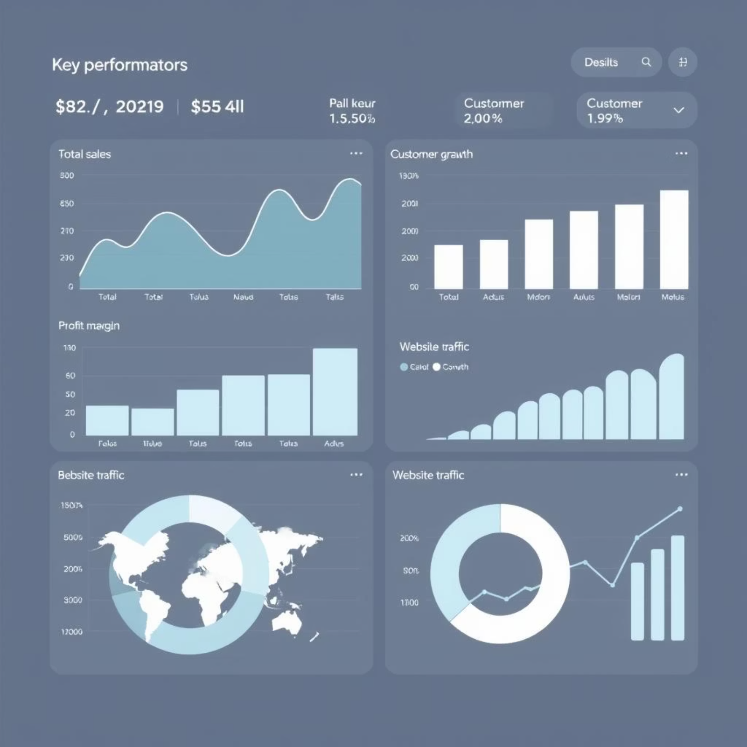
Testing, Output & Conclusion: Real-world Impact
Testing: Achieved up to 99.5% accuracy using 10-fold cross-validation, with precision and recall exceeding 96%.
Output: Clear stress level labels (low, medium, high) accompanied by confidence scores.
Impact: Real-time alerts enable timely interventions for effective stress management.
Conclusion: Our ML-based stress detection system is highly accurate, scalable, and crucial for promoting overall well-being.

